Slide 1
Maize Genome DataBase
Lingbin Ni
Aug.3,2017

Slide 2
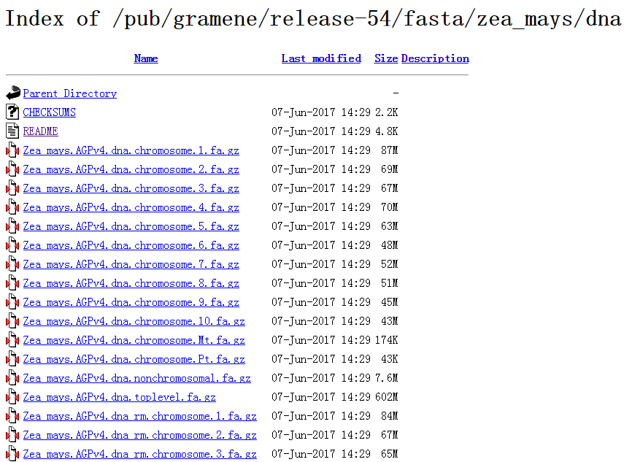
Data Source
Login:http://www.gramene.org
Download the maize genome
data

Slide 3
Data Source
Base: 2.1billion
Chromosome: 10 Chromosomes
Mt
Pt
Nonchromosomal
Storage:768GB(10 chromosomes)

Slide 4
DataBase Structure
Position | Base | Others
1 | A | ……
2 | T | ……
3 | G | ……
4 | C | ……
5 | T | ……
6 | A | ……
…… | …… | ……

Slide 5
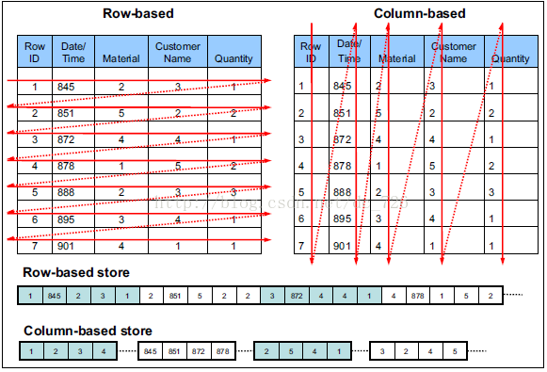
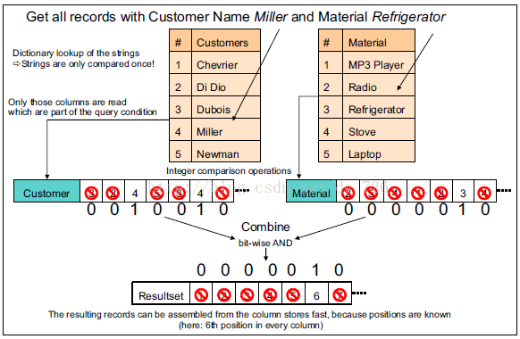
DataBase Structure

Slide 6
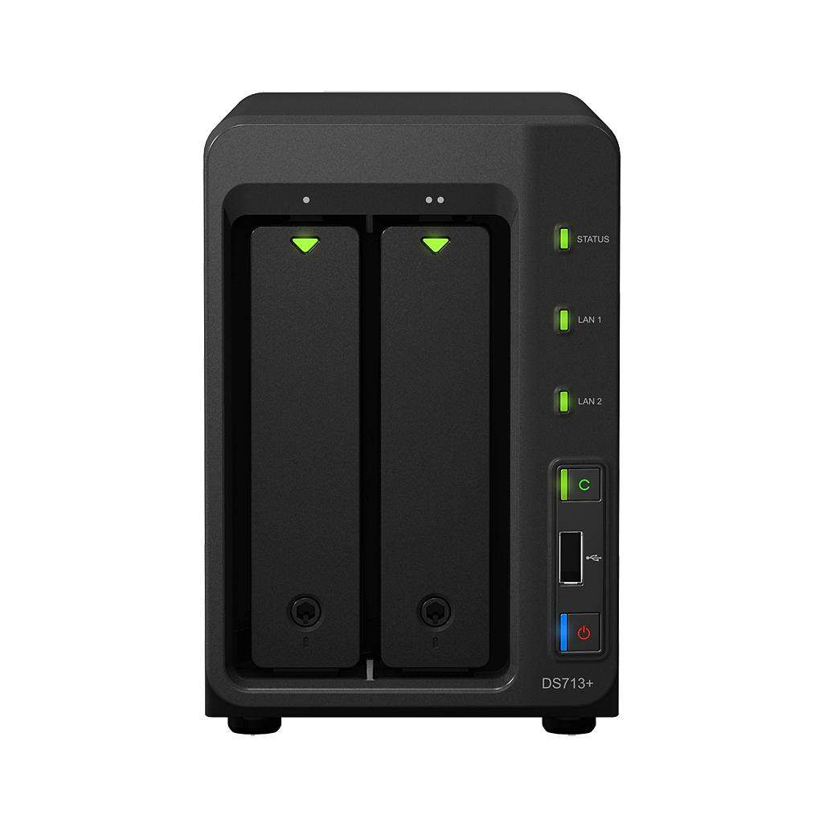

Server

Slide 7
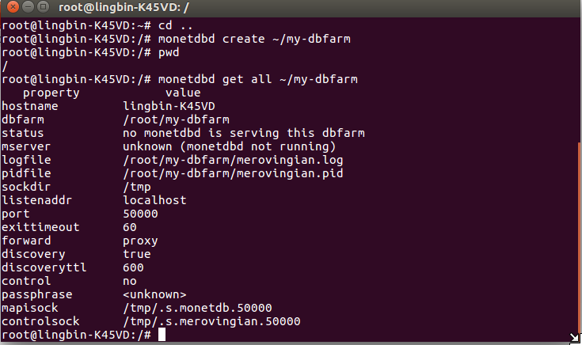
OS
Linux(Debian OR Ubuntu)

Slide 8
Data Import Strategy
1. Coding
KEY:Position
Binary File:1)-2 000 000 000~+2 000 000 000
2)XXXX(chromosome)+BasePosition
2. Convert to binary files
3. Bulk loading
https://www.monetdb.org/Documentation/Manuals/SQLreference/CopyInto
4. Convert to decimal files
5. Output the result

Slide 9
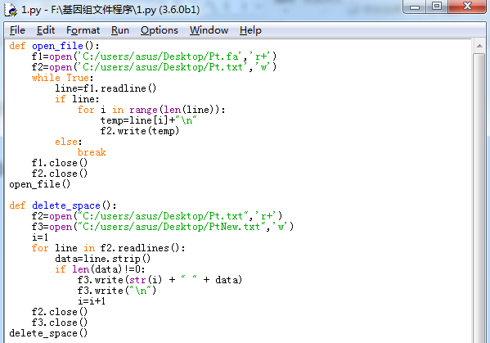
Data Import Strategy
Advanced Options
1)API
2)GUI
Playground

Slide 10
Thanks!

